Slide 1

Portuguese banking institution Marketing For a Term Loan Data Analysis
Simran Satija
(student)

Slide 2
Objectives of the study and analysis
Prepare a proposal document with every intricate detail and workings of the entire project.
Analyse the data and do an exploratory analysis weighing in various factor.
Process data preparation and cleaning using python libraries.
Build a Logistic Regression model using Machine Learning techniques to determine the best fit.
Thereby determining the best strategy for the business.

Slide 3
Problem Statement
The data is related with direct marketing campaigns (phone calls) of a Portuguese banking institution. The classification goal is to predict if the client will subscribe a term deposit (variable y).
The marketing campaigns were based on phone calls. Often, more than one contact to the same client was required, in order to access if the product (bank term deposit) would be ('yes') or not ('no') subscribed.

Slide 4
Data Information
Data set is in a csv form.
Data set consists of previous and present years data.
Data shape = 41188 rows and 21 columns
It has size of 5.56MB
Data columns are: [ 'age', 'job', 'marital', 'education', 'default', 'housing', 'loan', 'contact', 'month', 'day_of_week', 'duration', 'campaign', 'pdays','previous', 'poutcome', 'emp.var.rate', 'cons.price.idx', 'cons.conf.idx', 'euribor3m', 'nr.employed', ‘y’ ]

Slide 5
Tools Used
Jupyter Notebook
Python and Libraries: pandas, matplotlib, seaborn, joblib, NumPy and Scikit-learn.
Machine learning tools

Slide 6
Exploratory Data Analysis (EDA)
At what points along the duration and age is most of the data accumulated.
For how many people the marketing campaign was successful previously alongside how many people are considering subscribing to a term deposit.
For how many people the marketing campaign was a failure previously alongside how many people are considering subscribing to a term deposit.
Up to what duration, maximum people in this dataset prefer giving their time to such marketing campaigns contact point.
what was the age bracket most of the people in the dataset belonged to?
How much contact was made with the client alongside what proportion of them are subscribing to and not subscribing to the term deposit.
How many of each category professionals are subscribing to the term deposits.
How many of each category of marital statuses are subscribing to the term deposits.
How many of each category of educational backgrounds are subscribing to the term deposits.
How many people have made defaults in their last loans, how many have an existing housing loan and a personal loan; how many of each of these people are going to subscribe for the term loans.
How many contacts were made in the previous campaigns for these clients and how many of them are going to opt for the term deposit scheme in this campaign.

Slide 7
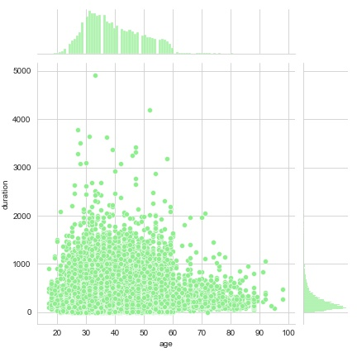
Most of the data is cumulated up to duration 2000 seconds and age 20-60 years. Indicating people prefer not to give more than about 30 minutes of there time to such campaigns.

Slide 8
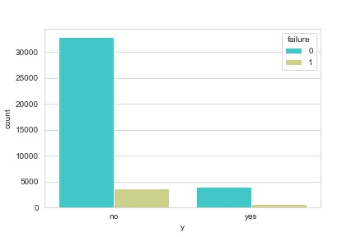
The above count plot shows for how many people the marketing campaign was successful previously alongside how many people are considering subscribing to a term deposit.

Slide 9
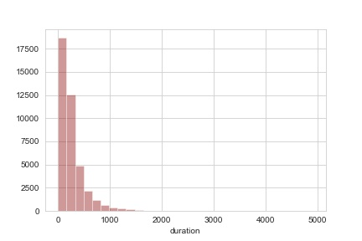
The above distplot shows up to what duration, maximum people in this dataset prefer giving their time to such marketing campaigns contact point.

Slide 10
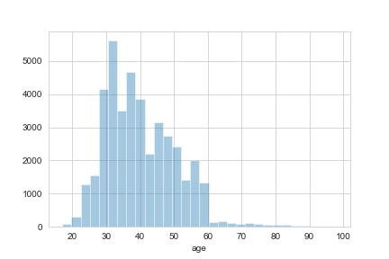
The above distplot shows up to what was the age bracket most of the people in the dataset belonged to which is 20-60.

Slide 11
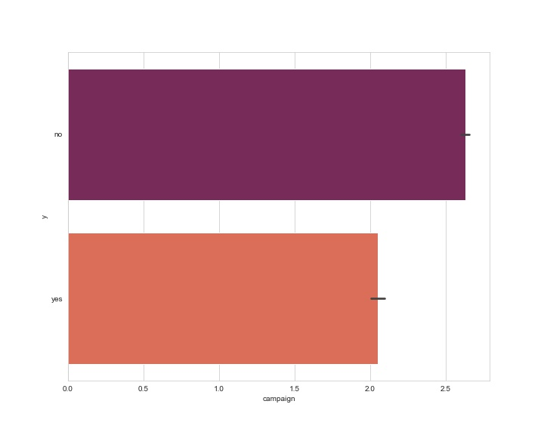
The above barplot shows how much contact was made with the client alongside what proportion of them are subscribing to and not subscribing to the term deposit.

Slide 12
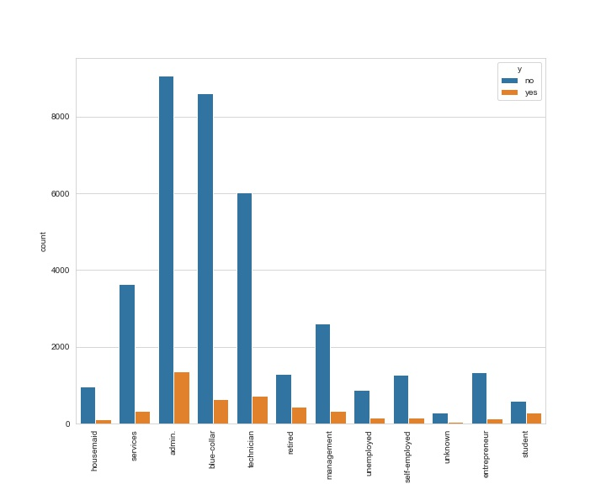
The above count plot shows how many of each category professionals are subscribing to the term deposits.

Slide 13
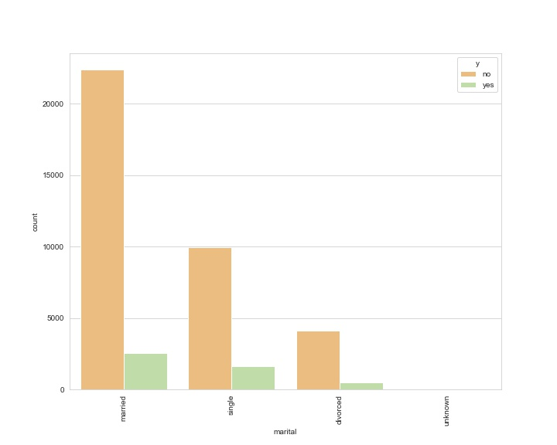
The above countplot shows how many of each category of marital statuses are subscribing to the term deposits.

Slide 14
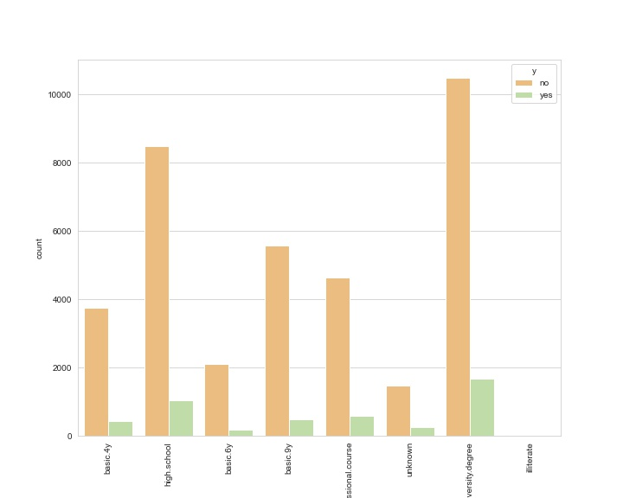
The above countplot shows how many of each category of educational backgrounds are subscribing to the term deposits.

Slide 15
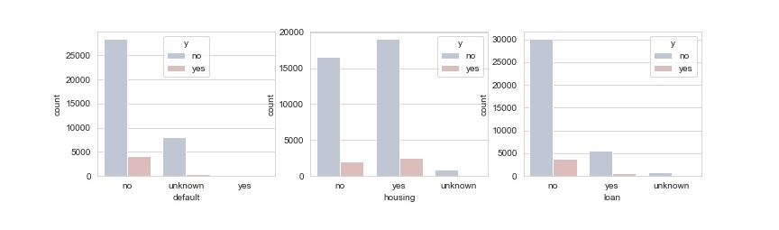
The above count plots shows how many people have made defaults in their last loans, how many have an existing housing loan and a personal loan ; how many of each of these people are going to subscribe for the term loans.

Slide 16
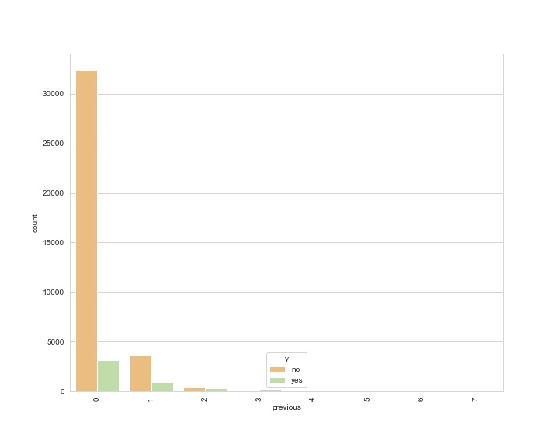
The above countplot shows how many contacts were made in the previous campaigns for these clients and how many of them are going to opt for the term deposit scheme in this campaign.

Slide 17
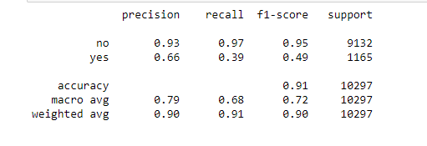
Predictions

Slide 18
THANK YOU

